Slide 1

Visual Merchandising

Slide 2
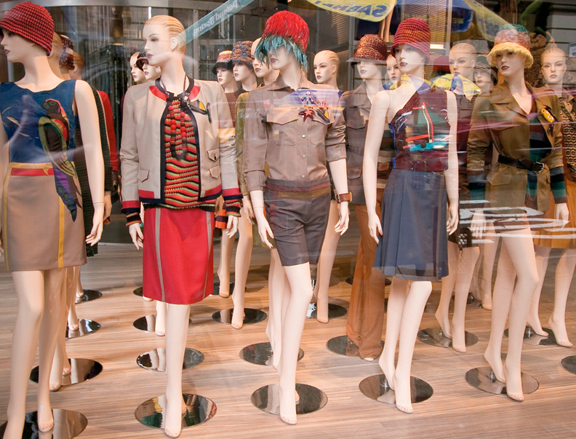
Chapter 18
Visual Merchandising and Display
  Section 18.1 Display Features
  Section 18.2 Artistic Design

Slide 3
Artistic Design
  Objectives
  Types of Displays
  List the five steps in creating a display
  Explain how artistic elements function in display design
  Describe the importance of display maintenance
Marketing Essentials Chapter 18, Section 18.2

Slide 4
Types of Displays

Slide 5
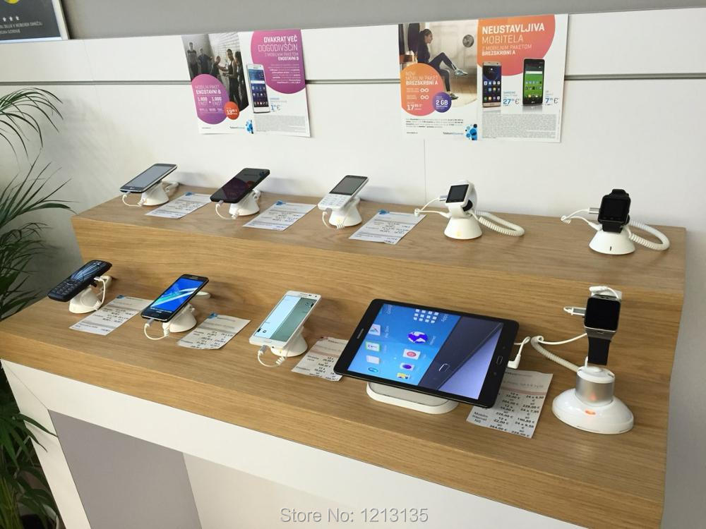
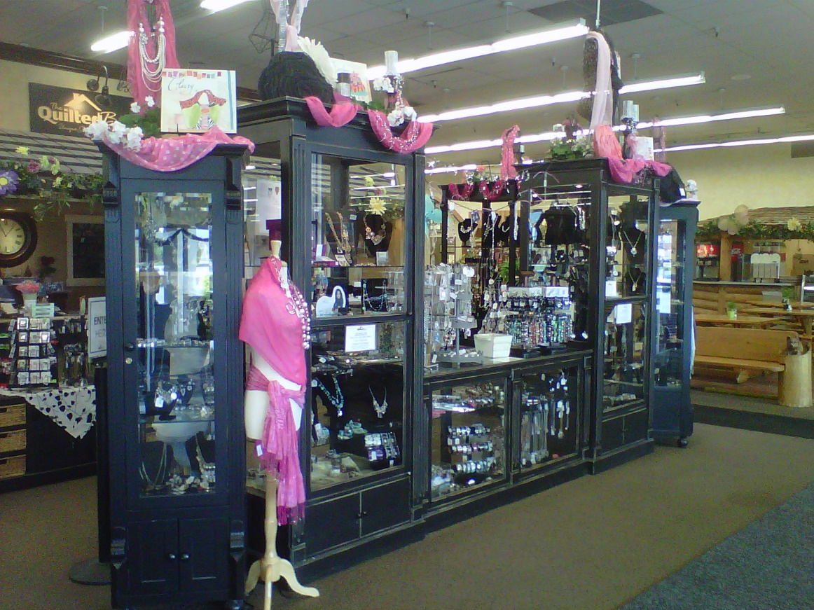
Interior Displays: creative, innovative, or well-organized ways to showcase your products with stands/display cases
If interior displays are done well, they enable customers to make a selection without the assistance of a
salesclerk
Ex: Unless the intent is to not
allow customers to do it alone due
to the value of the product

Slide 6
Group Activity
Pre-Assignment Game – Types of Displays
In Groups of three, take the puzzle pieces and put them in the correct category of displays:
Types of displays:
  Closed displays
  Open displays
  Architectural displays
  Point-of-purchase displays
  Decorations

Slide 7

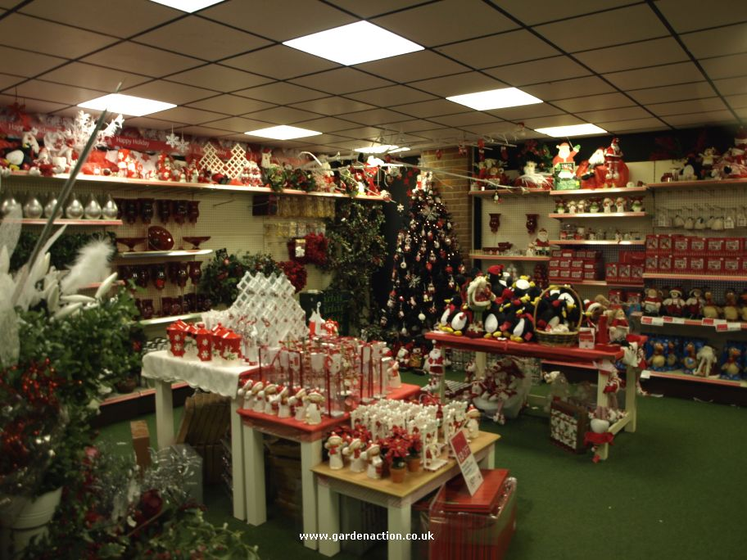
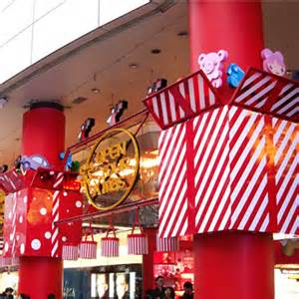
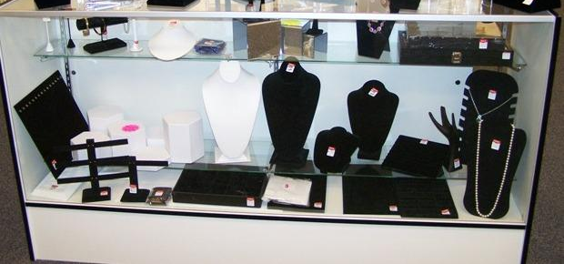
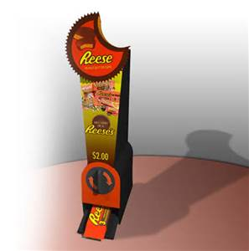

Slide 8
Type of Interior Displays:
Five types of interior displays are:
  Closed displays
  Open displays
  Architectural displays
  Point-of-purchase displays
  Decorations
Marketing Essentials Chapter 18, Section 18.1

Slide 9
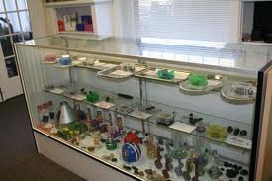
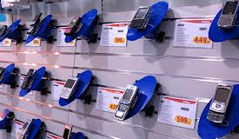
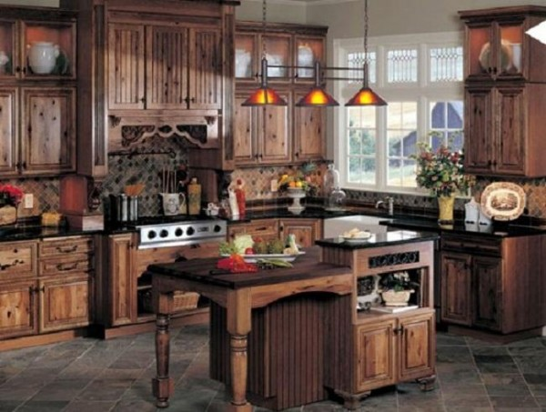
Closed Displays: customer can see
but can’t handle the merchandise
(jewelry cases)
Open Displays: can handle and
examine merchandise
(tables, shelves and countertops)
Architectural Displays: model
rooms show how it would look in
a room (kitchen model at Menards)

Slide 10
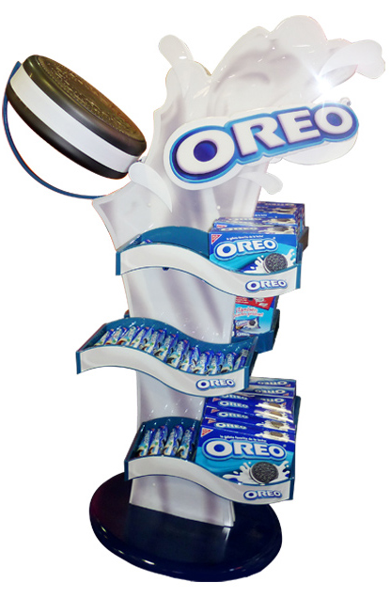
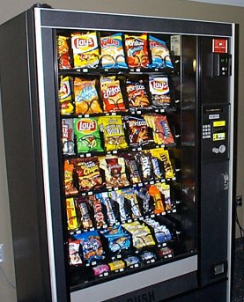
Point-of-purchase displays (POPs) X
are consumer sales promotion devices with bold graphics and signage that hold, display, or dispense specific products
They promote impulse purchases
Examples include:
  Displays designed for a specific product
  Vending machines
  Racks at a checkout stand
  (candy racks)

Slide 11
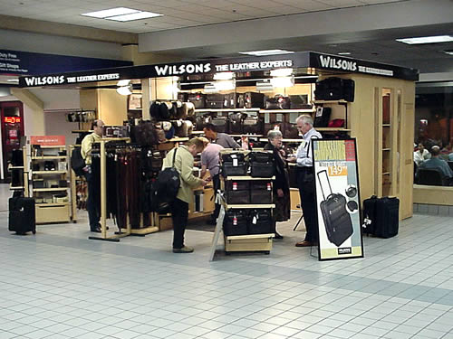
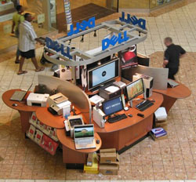
Kiosks X are interactive
point-of-purchase (displays items
and has a till or POS for purchase)
or retail stands, that take up only
a few square feet of floor space –
can be inside or outside a store.
Ex: jewelry stands, sunglass stands in
the middle of the mall, in airports
They are popular because of:
  Immediate product availability
  Offer Unique products
  Less expensive then store space

Slide 12
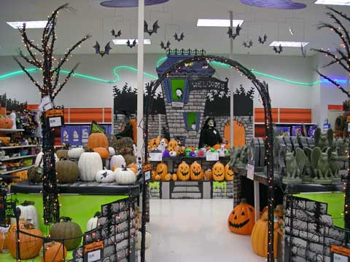
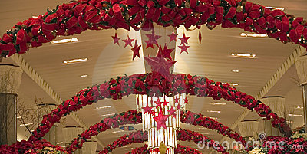
Store Decorations: displays that coincide with seasons or holidays. Banners, signs, graphics and props used to create atmosphere

Slide 13
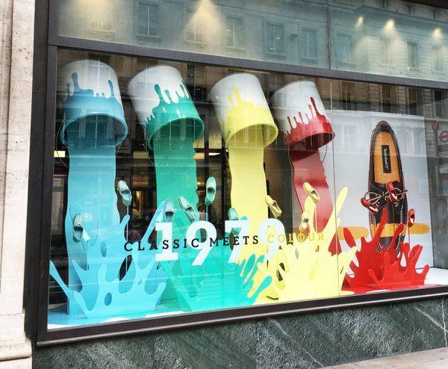

Slide 14

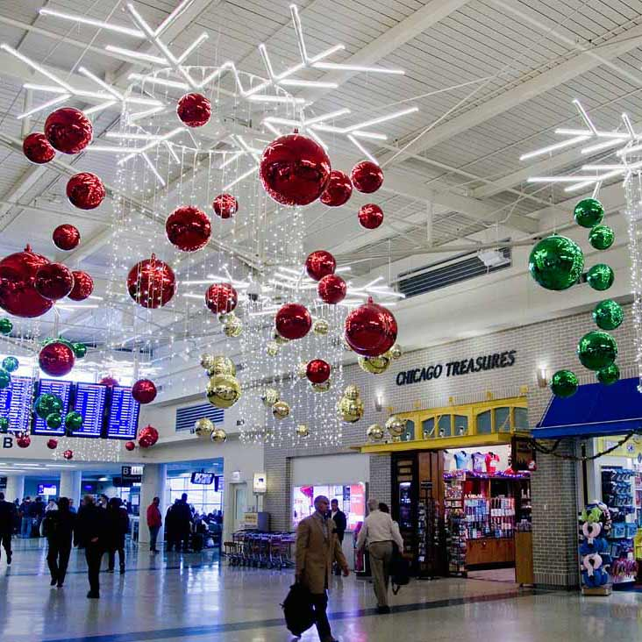
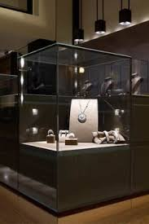
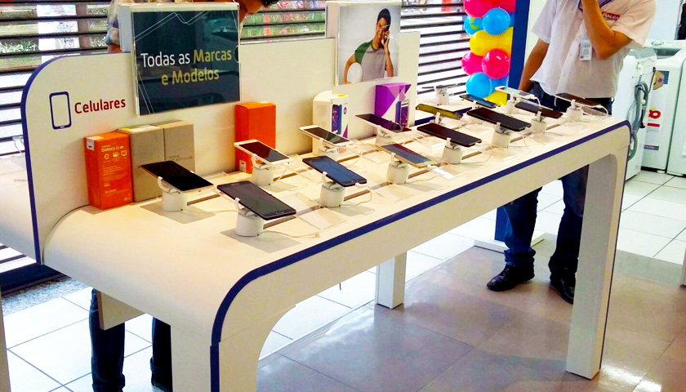
What type of display: Closed , Open, Architectural
Point-of-purchase, Decorations or kiosk

Slide 15
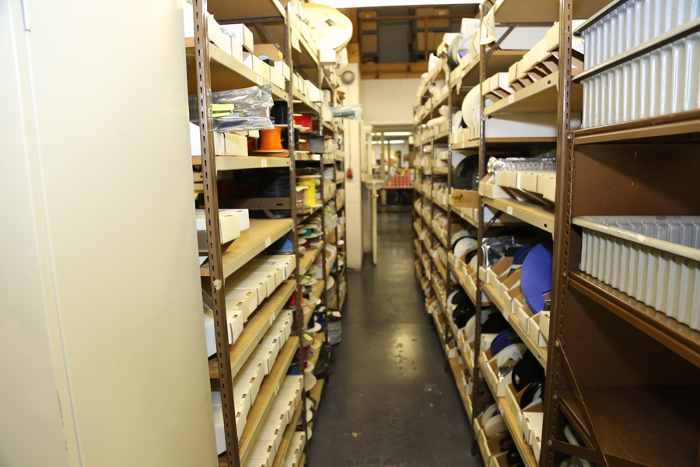
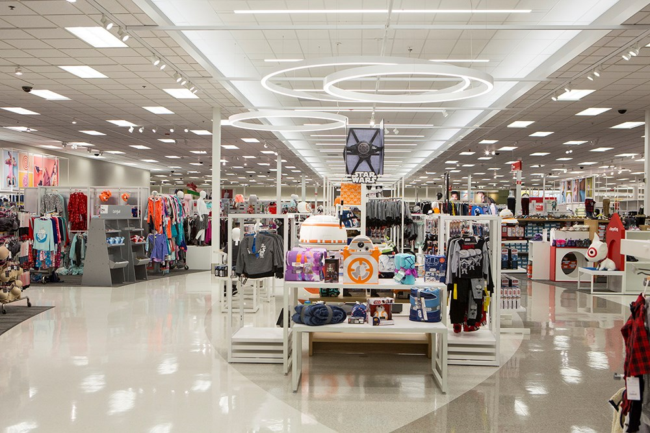
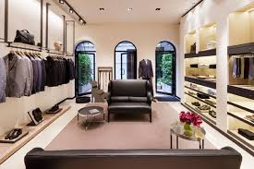
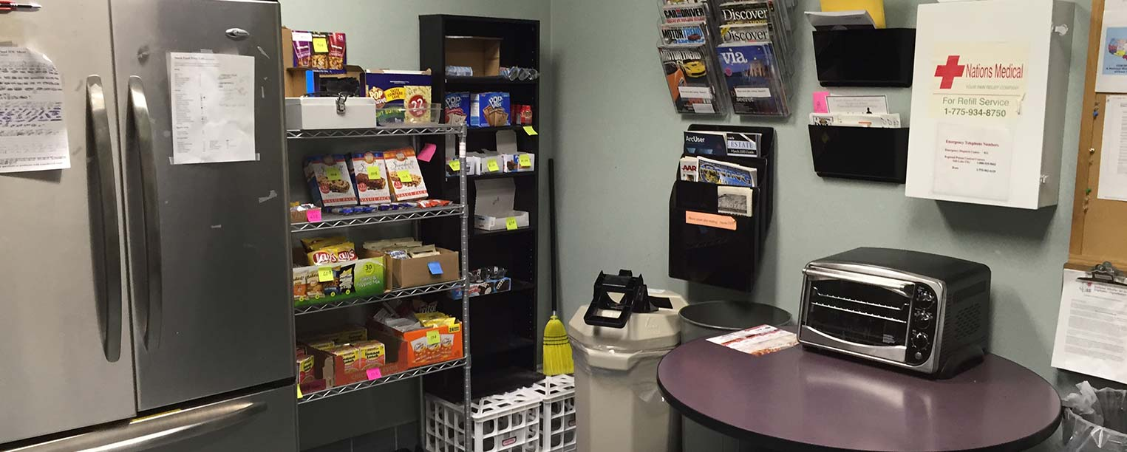
Which of the 4 areas of store layout is it?

Slide 16
Display Design and Preparation
How long does a display have to attract customer attention?
Displays generally have about four to six seconds to attract a customer’s attention, create a desire, and sell a product

Slide 17
5 Steps to creating a Display
Display design involves five steps:
Selecting the right merchandise
Selecting which product display format
Choosing a setting
Manipulating artistic elements
Maintain completed displays

Slide 18
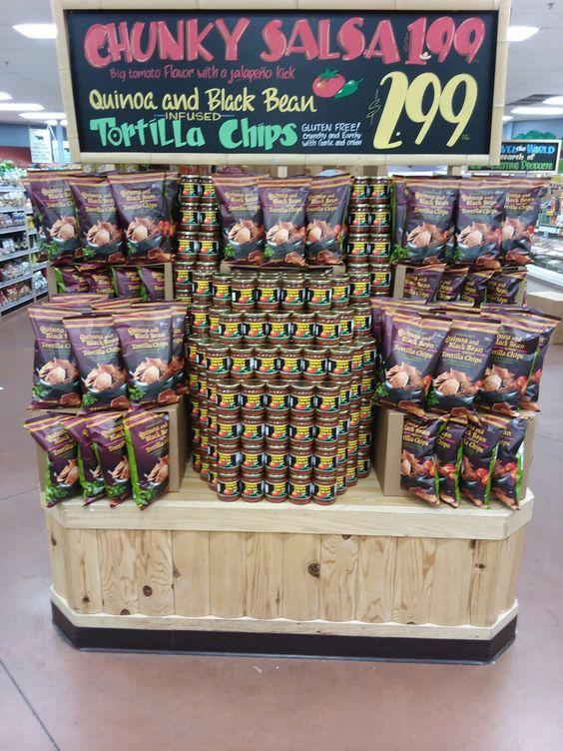
1. Selecting the Merchandise
Display merchandise must be:
visually appealing
contemporary
appropriate for the season and
geographic area

Slide 19
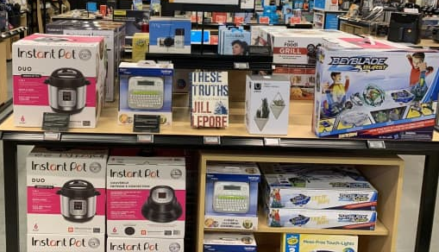
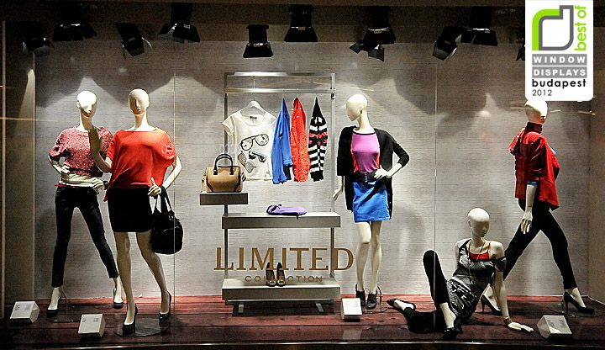
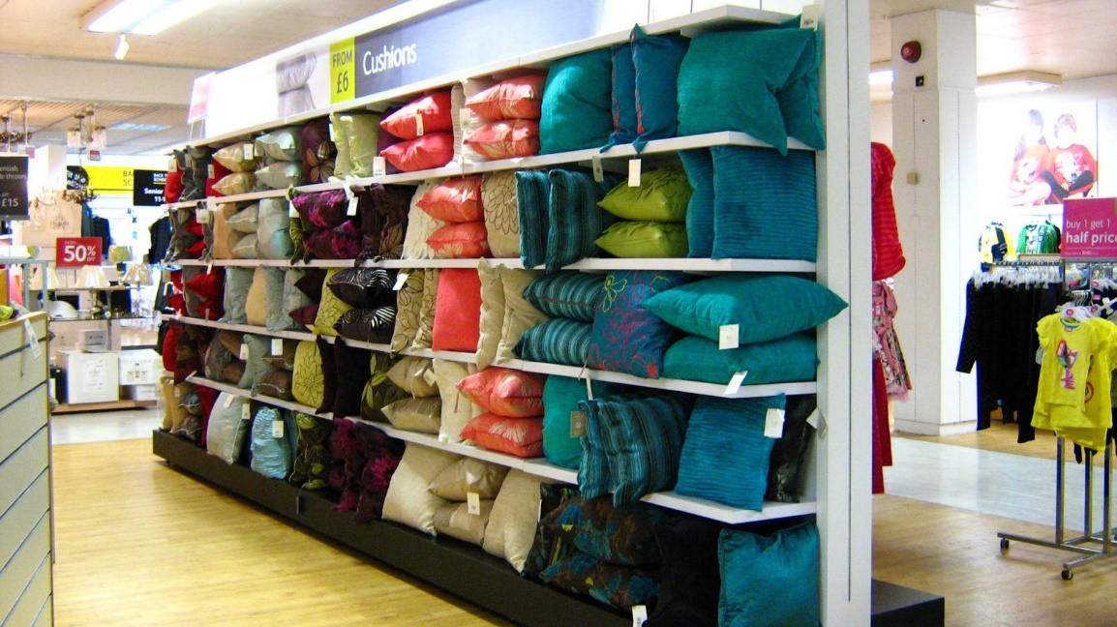
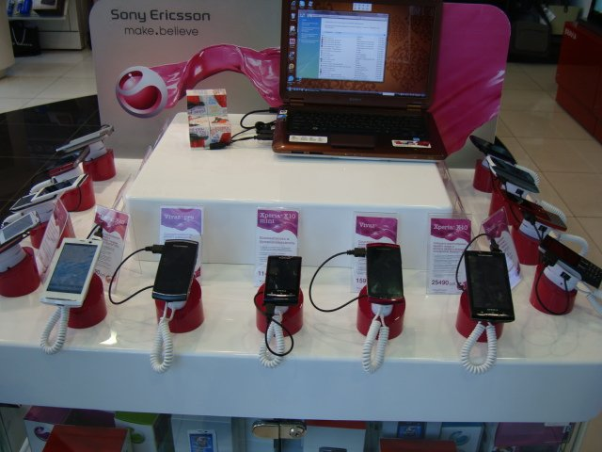
2. Selecting the Product Display Format
The merchandise selected to display determines how it will be displayed as a:
  One item display, showing a single item, one brand, Same shirt, same design, different colors
  Similar-product display: showing one kind of item from different brands
    Watch display with Fossil, Rolex, etc…
  Related-merchandise display, grouping items that can be used together
    Skirt, shirt, shoes, and jewelry
  Cross-mix display: a variety of different merchandise displayed together
    Clothing, camping equipment, shoes,
    and perfume

Slide 20
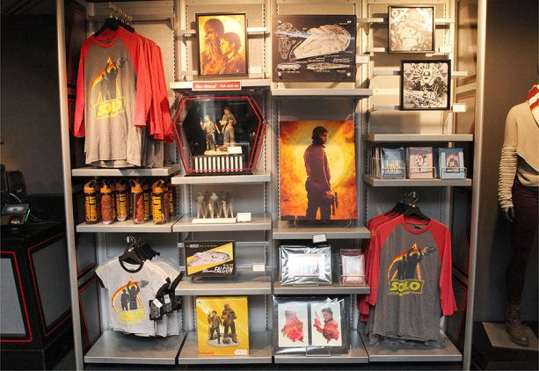

Slide 21
Display Types assignments
Google Classroom

Slide 22
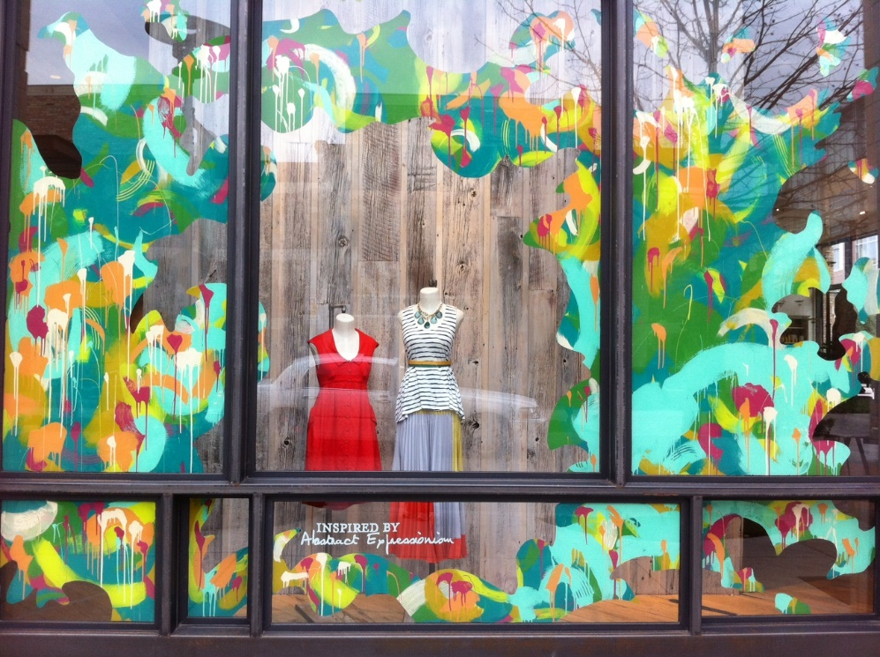
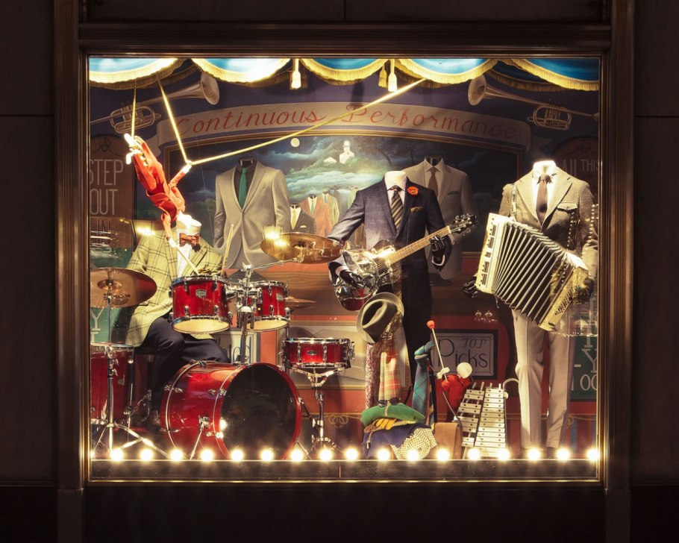

3. Choosing a Display Setting
A display setting used depends on the image it wants to project. Settings can be:
  Realistic – depicts a room or recognizable locale Props like tables, chairs, plants, riser books, dishes etc provide details (restaurant, park etc.)
  Semi-realistic – a room or recognizable locale but leaves details to the imagination
  Abstract – does not imitate nor try to imitate a reality – focus on form and color versus actual objects

Slide 23
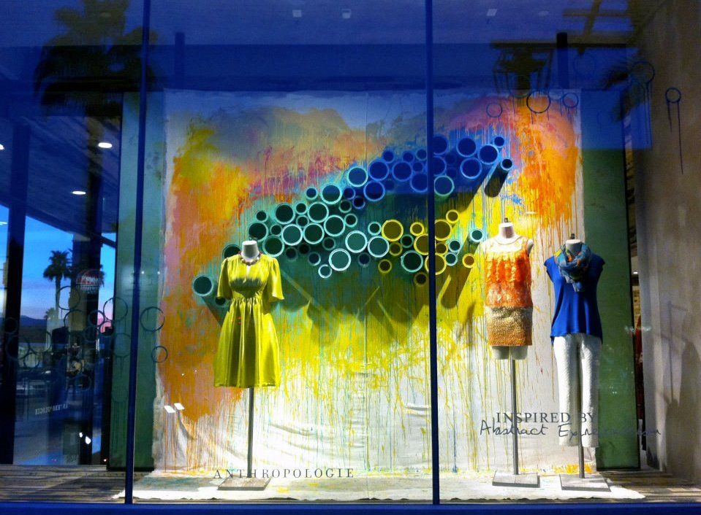
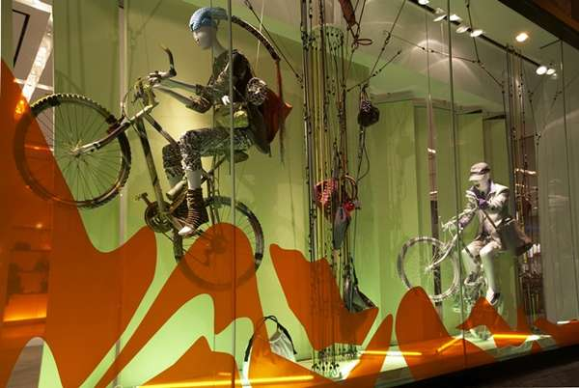
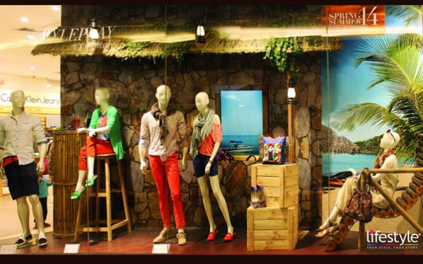

Slide 24
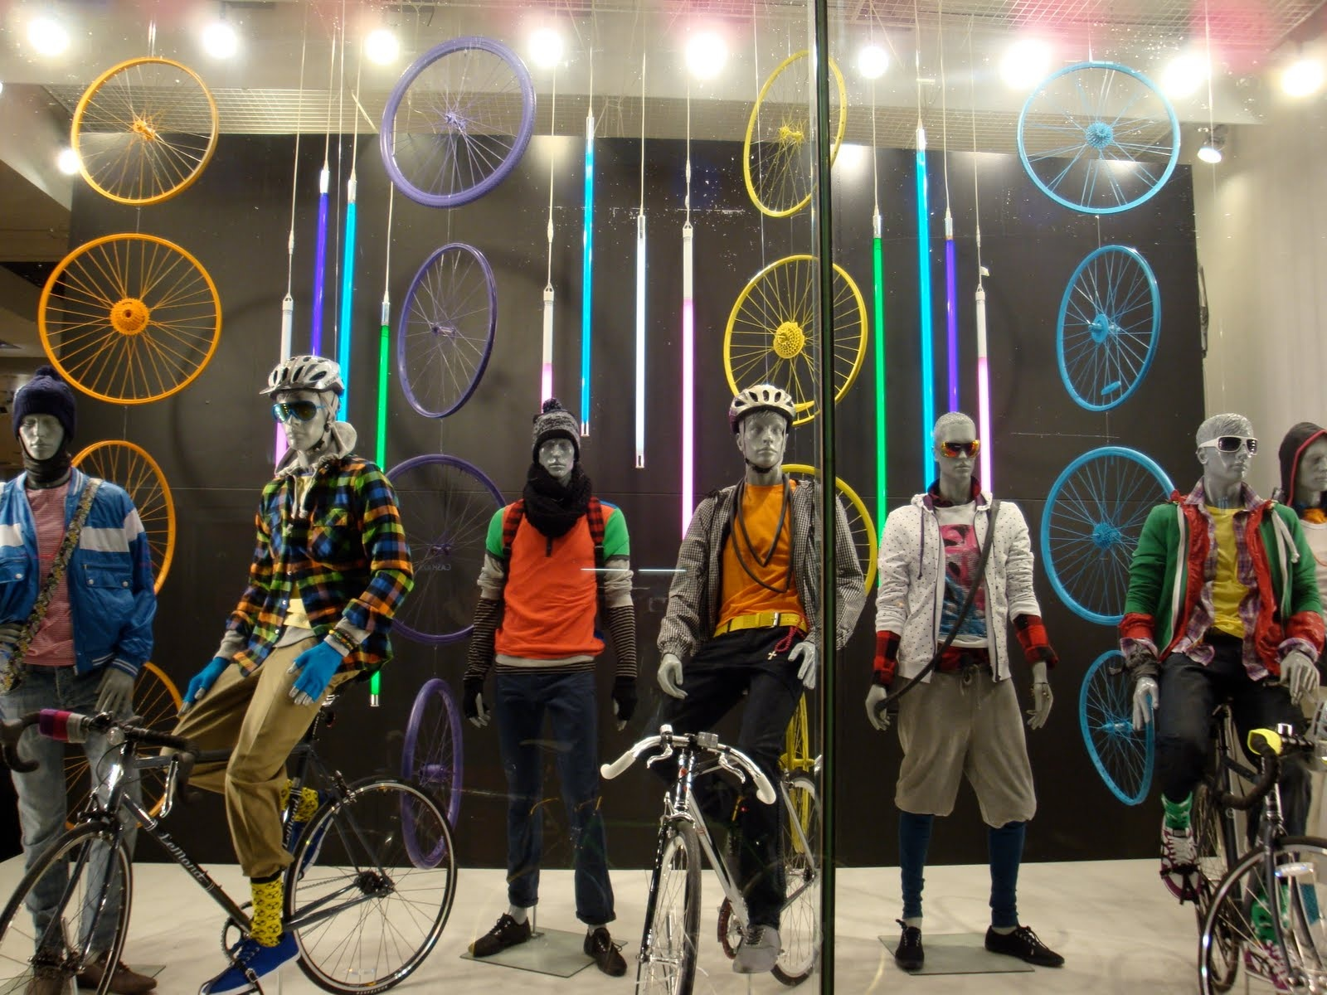
4. Manipulating Artistic Elements
The artistic elements of a display include:
  Use Lines – straight, curvy, horizontal etc. to draw attention of the customer
  Color: Display colors should make the display stand out and are critical to display effectiveness
Marketing Essentials Chapter 18, Section 18.2

Slide 25
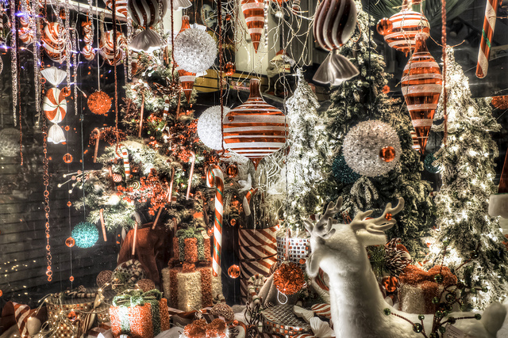
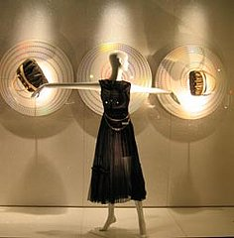
C. Direction
Effective displays have a focal point
focal point: an area in the display that attracts attention first, above all else (should be the merchandise)

Slide 26
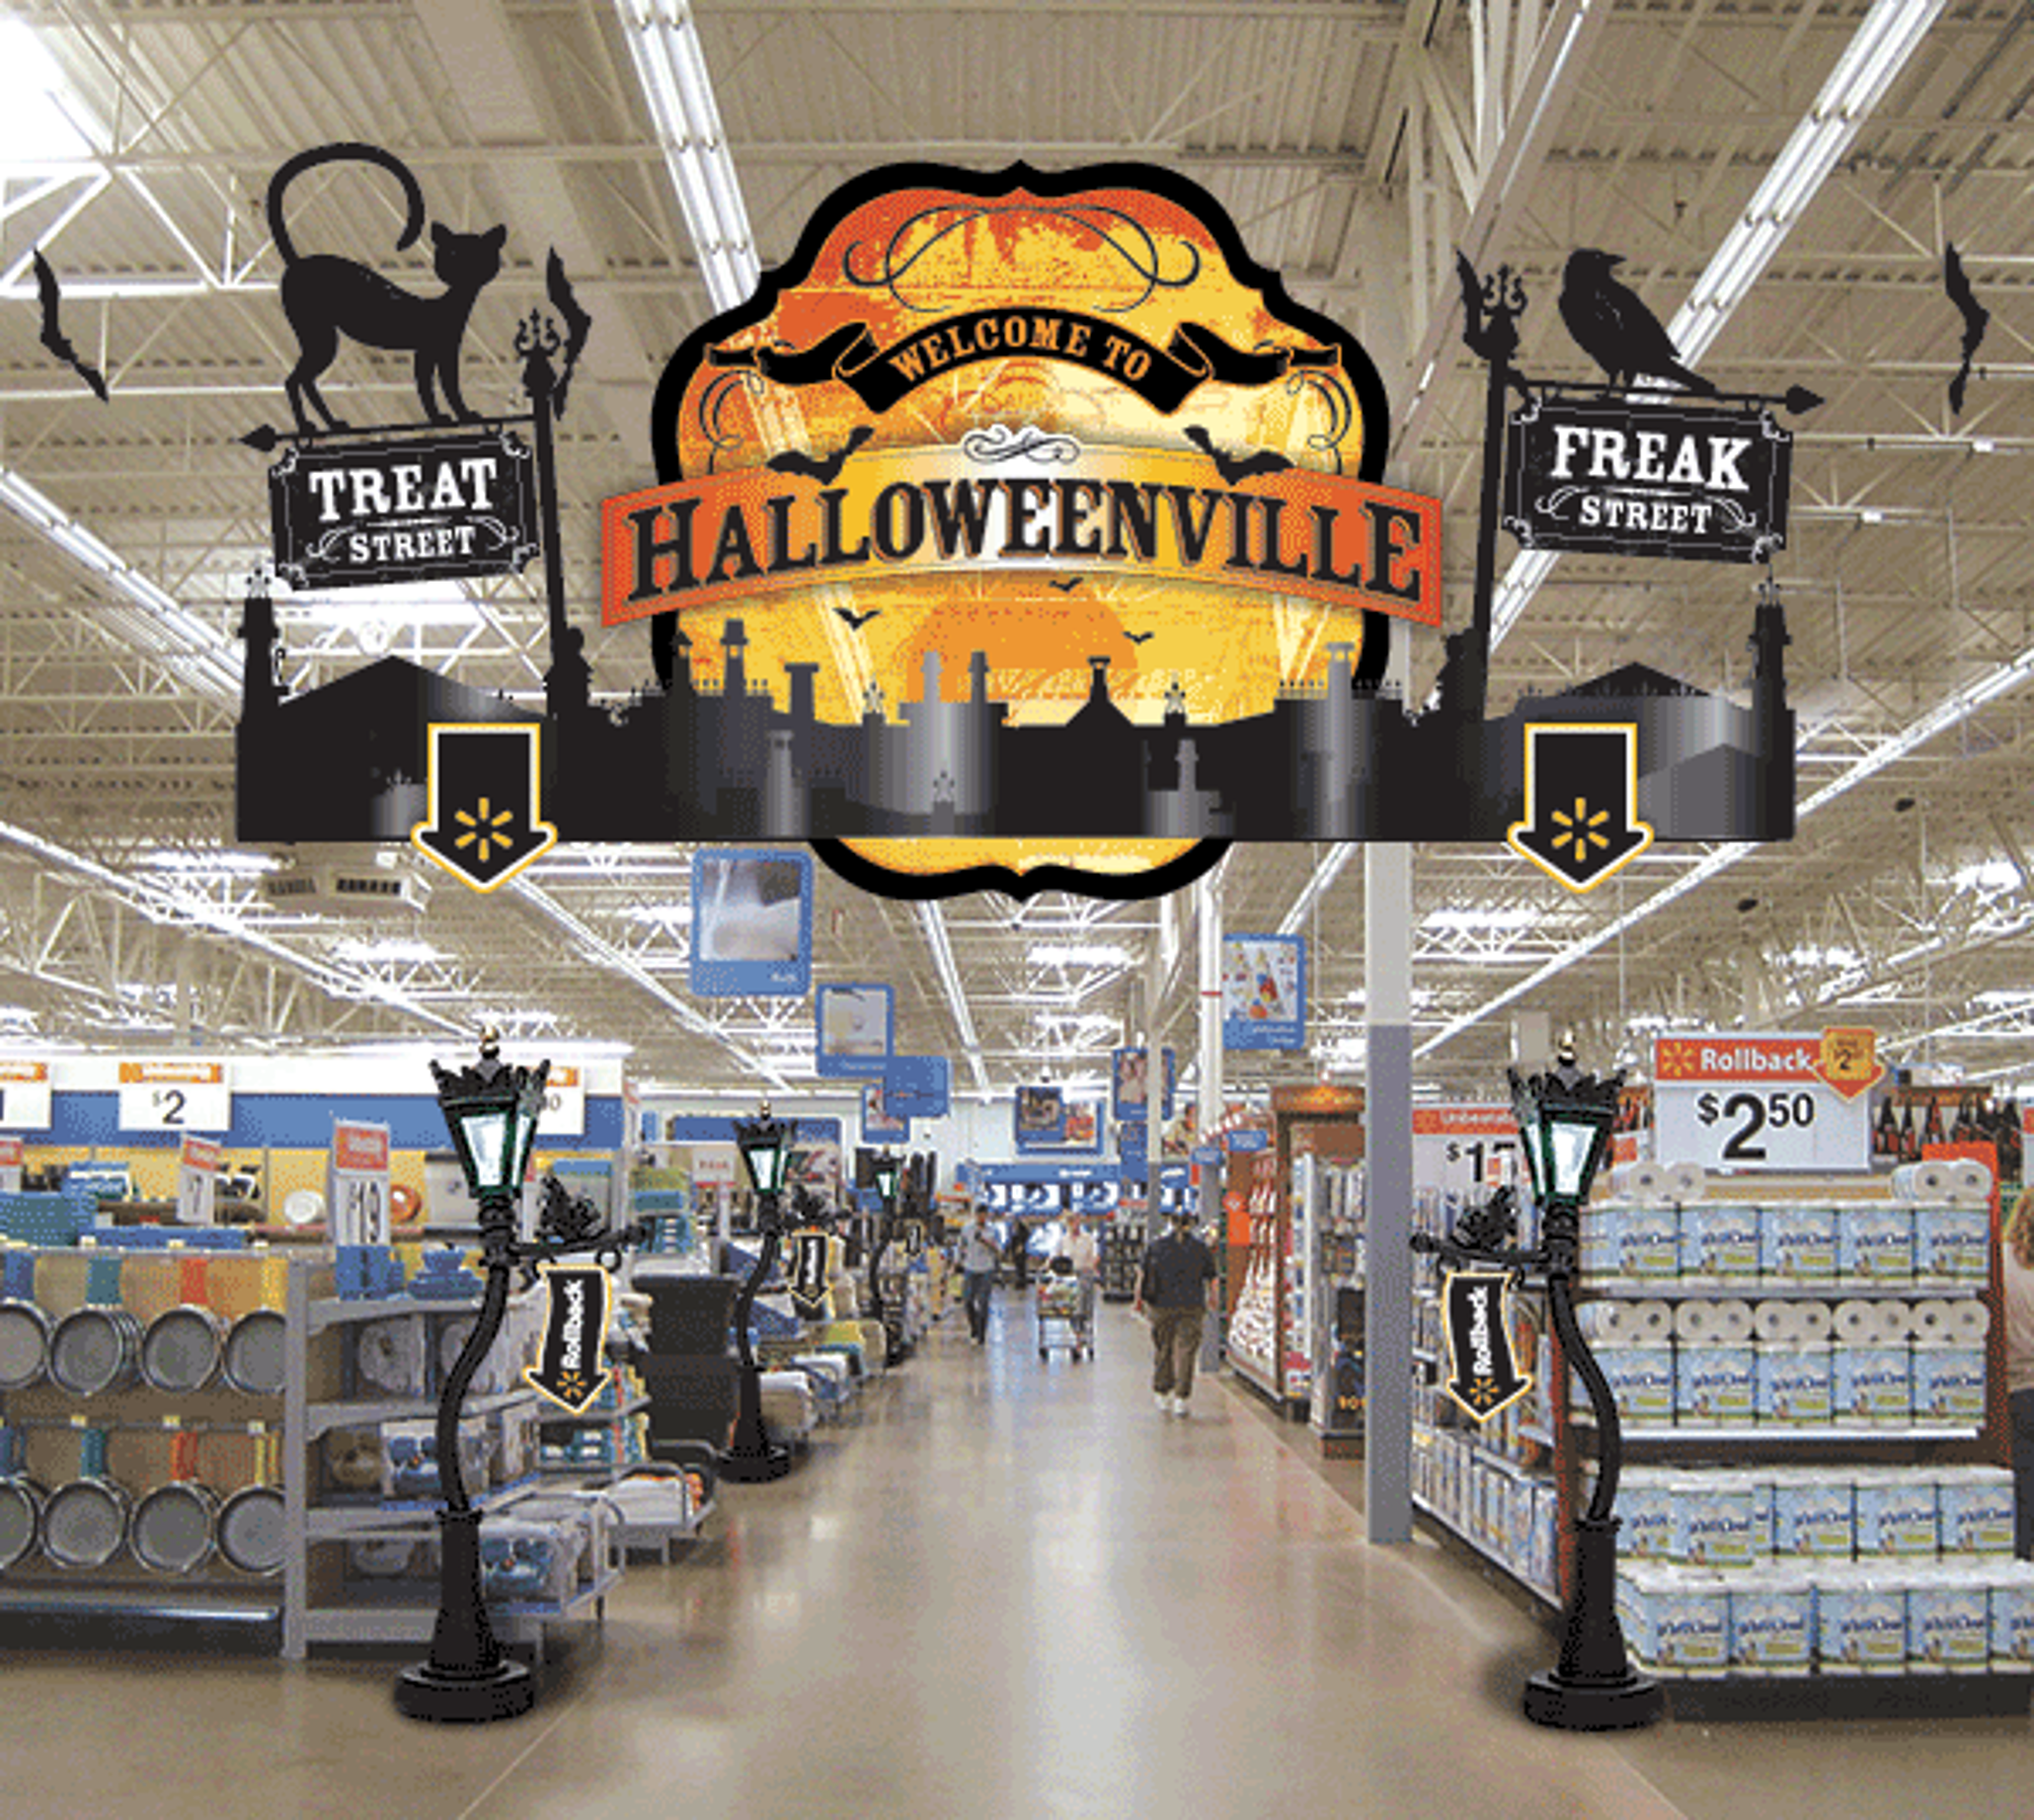
d. Motion
Motion is playing an increasingly important role in display design
Animation can be achieved through the use of motorized fixtures, props, and mannequins
Should be used sparingly
Example: – in this
display the bats fly around the
signage
Marketing Essentials Chapter 18, Section 18.2

Slide 27
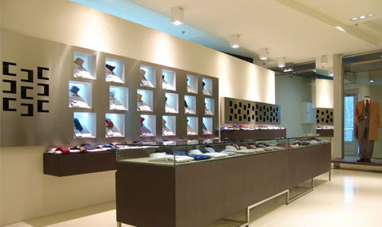
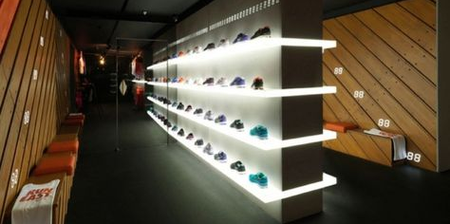
e. Lighting
Proper lighting is critical to attractive displays
recommended lighting be two to five times stronger than a store’s general lighting
Colored lighting can create dramatic effects
Marketing Essentials Chapter 18, Section 18.2

Slide 28
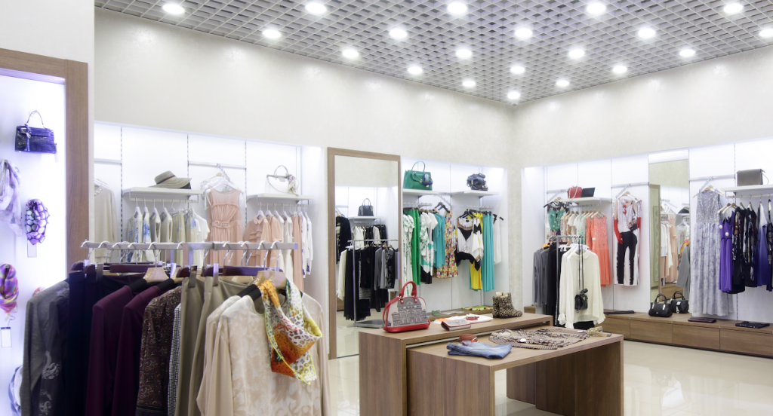
Ceiling, display and wall lights

Slide 29
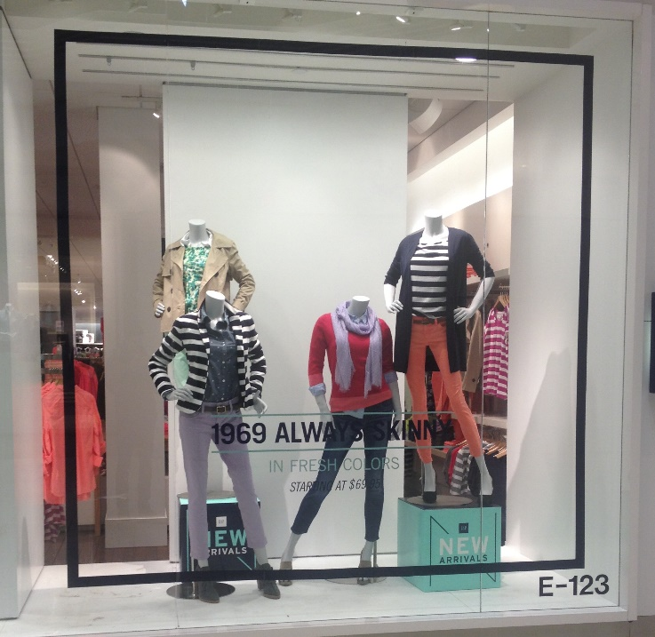
F. Proportion
Proportion X refers to the relationship between and among objects in a display
Props, graphics, and signs should be in proportion
Too many props detracts
from merchandise.
Marketing Essentials Chapter 18, Section 18.2

Slide 30
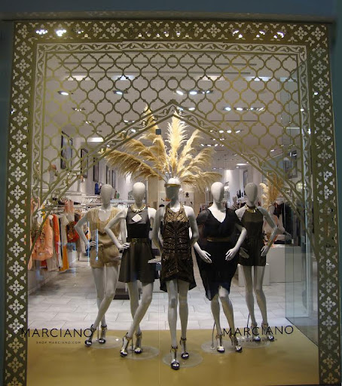
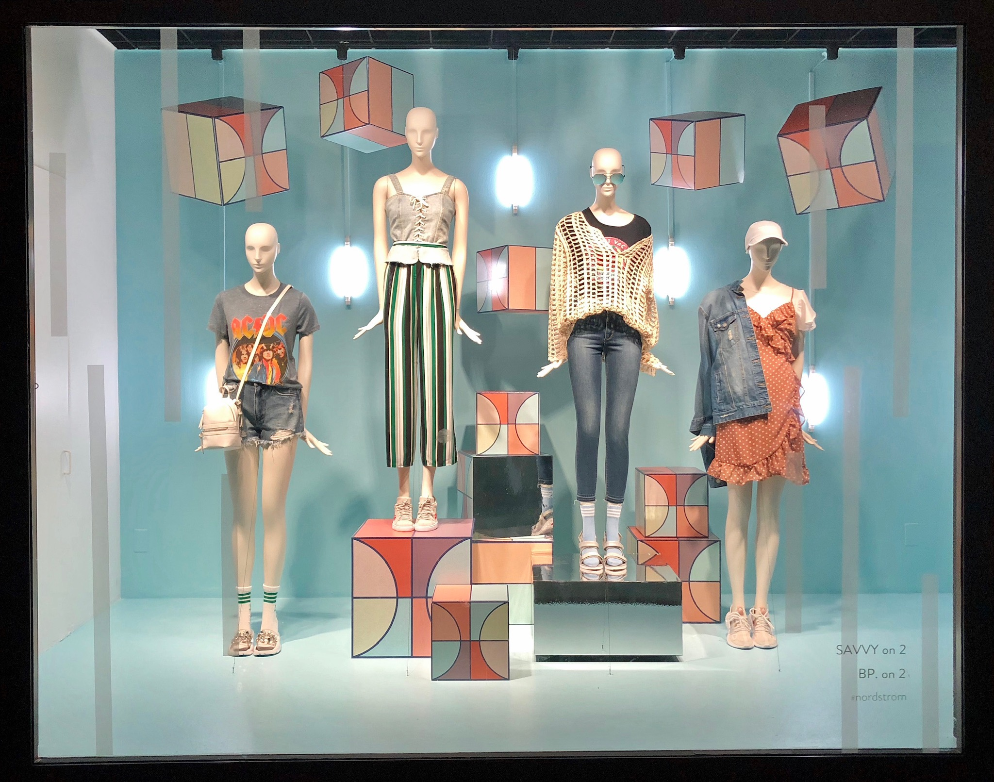
G. Balance
Formal balance X in a display happens when items of similar size are grouped together, or they are placed in opposite positions to balance one another out
Informal balance – occurs when small items are grouped with a large item (placed together) (ex: boxes are different sizes and used to make the mannequins look different sizes)
Marketing Essentials Chapter 18, Section 18.2

Slide 31

5 Display Maintenance
Displays need to be maintained
and eventually dismantled
Most businesses check displays
daily
Maintenance includes:
  Restock merchandise around displays daily
  Fix damage, displacements, or missing items
  Dust and clean area often
Poor maintenance can create a negative image of the store and merchandise
Marketing Essentials Chapter 18, Section 18.2

Slide 32
Complete the Review for 18-2 Constructing Displays

Slide 33
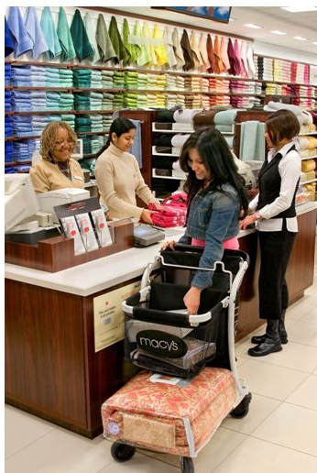
Merchandise Presentation Techniques
Rule of Three
Pyramid
Idea Orientation
Color Organization
Price Lining
Vertical Merchandising
Tonnage Merchandising
Front Presentation

Slide 34
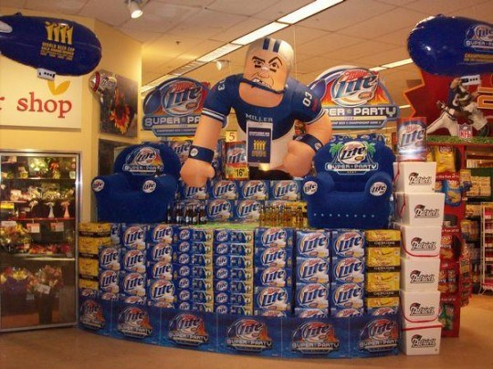
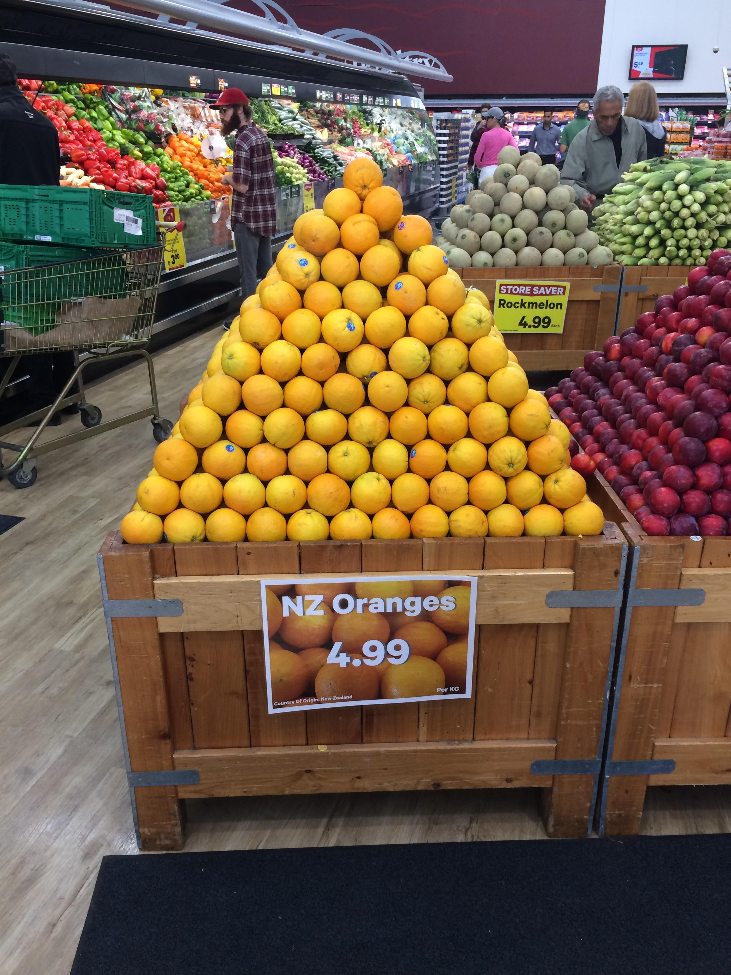

Presentation Techniques
The Rule of Three - Arranging products in sets of three, side-by-side. Ex: mannequins side by side, with formal or informal balance
The Pyramid Principle - Build a pyramid (with 3 or more items) with the largest item in the center, it draws your eye to the middle.
Idea-Oriented Presentation - Build a display based on a theme (i.e. seasonal) or a store-branding image.

Slide 35
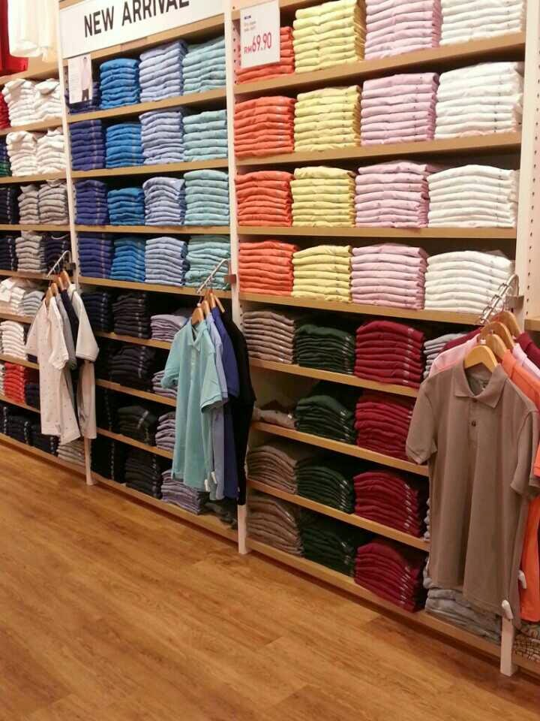
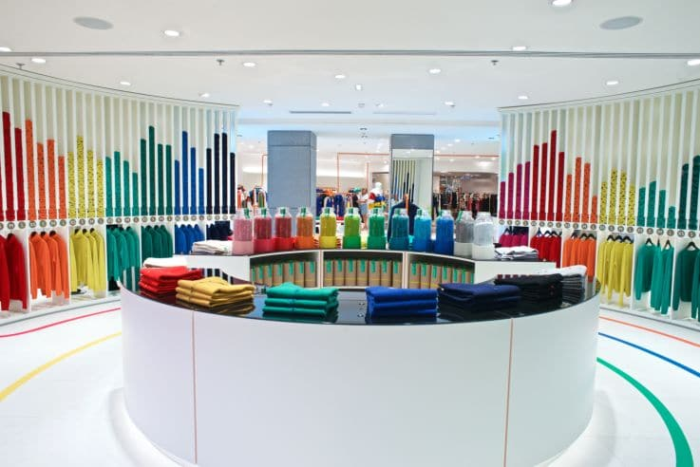
Color Coding – organizing product
by color
Displays the many color options
Can make certain items seems
more attractive than others
Can provide direction to customers
Improve shopping experience

Slide 36


Vertical Merchandising - use walls or taller gondolas and put the most popular items at the customer's eye level.
Tonnage Merchandising - purchasing large quantities of merchandise and make them a focal point display, like items on a pallet in an aisle in Home Depot or Lowe's.

Slide 37

Frontal Presentation - display as much of the product as possible together to catch the customer's eye, like the chips and beer display in the front of the grocery store the week before a big football game.
(not just 1 case of AW many along with many corresponding flavors)

Slide 38

Frontal = all one product, many colors and showing as much as possible

Slide 39


Price-Lining - have a couple of price points for a class of items, such as a premium brand
and a store brand item, and put them together
Web subscriptions with higher pricing for more features – heavily used in markets today

Slide 40

Artistic Design
Graphic Organizer
As you review this section, identify the key steps in display in a flow chart like this one.
Marketing Essentials Chapter 18, Section 18.2

